Slide 1

GAIT : a new fingerprint?
Aydin Uzun, Oussama Skhiri
Technical University of Munich
Student presentation of the TUM lecture
Clinical Applications of Computational Medicine
Munich, 10. March 2021

Slide 2
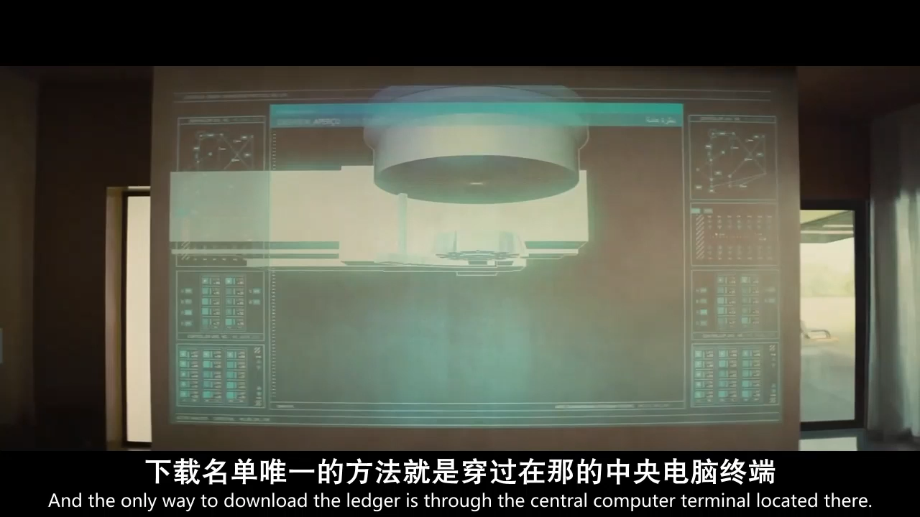

Slide 3
Comparison with other biometrics (Face, Fingerprint)?
Not private
Easy to hack

Slide 4
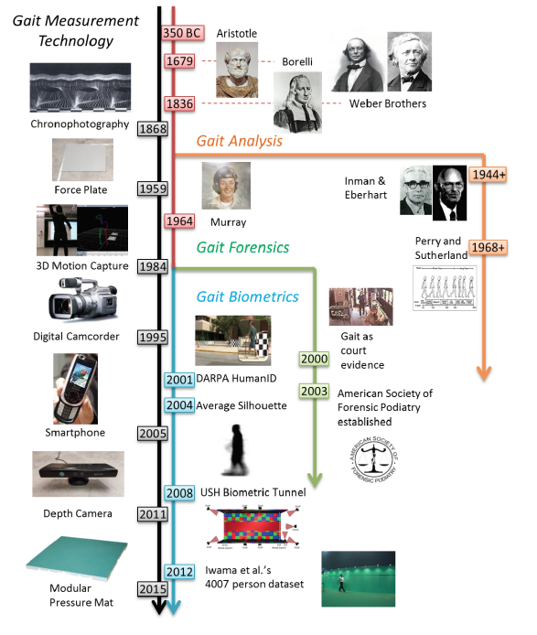
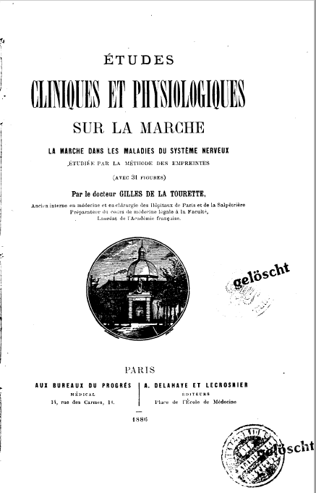
Timeline and Taxonomy

Slide 5
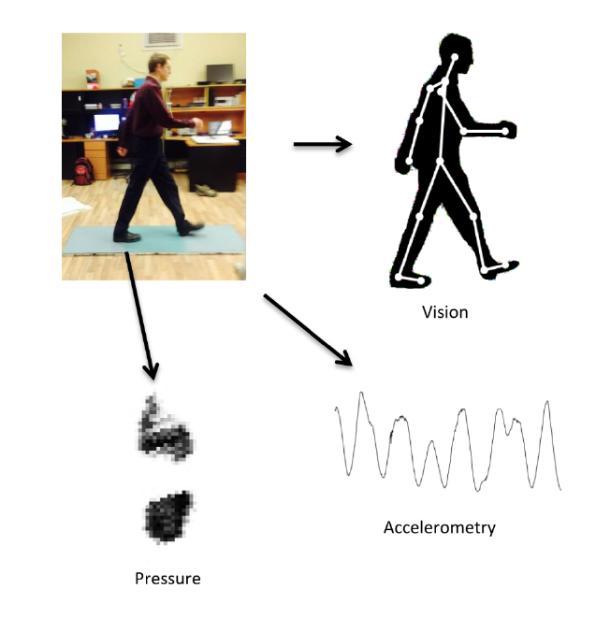
Sensor Modalities

Slide 6
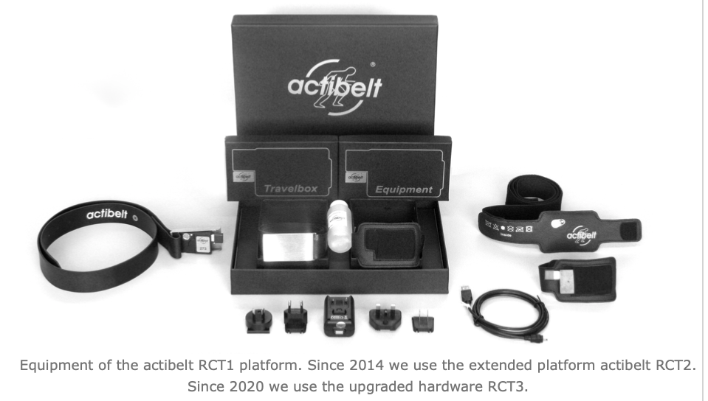
Actibelt Hardware Basics
 | RCT2 | RCT3
Dim. (LxHxW) | 70x40x10 mm | 70x40x10 mm
weight | 50g | 50g
Battery cap. | 1000 mAh (>2 months) | 1000 mAh (>2 months)
Storage cap. | 4 GB (75 days) | 4 GB (75 days)
Built in sensors | 3D Accelerometer, Hall effect sensor | 3D accelerometer, 3D Gyroscope, 3D Magnetometer, Barometer,Hall effect sensor
Timing Accuracy | 10 ppm | 5 ppm
Sampling rate | 100 Hz | 100 Hz
3D accelerometer hidden in a belt buckle
High resolution (13 bit) up to +/- 6g (noise<0.01g, 100 Hz in 3 axes)
Measures static acc. + dynamic acc.
High resolution -> as little as 0.25°
2014 RCT2, 2020 RCT3
Clinical Applications of Computational Medicine
6

Slide 7


Slide 8
Normstep algorithm
Raw data from actibelt
StepAnalyzer algorithm
Post process of steps

Slide 9
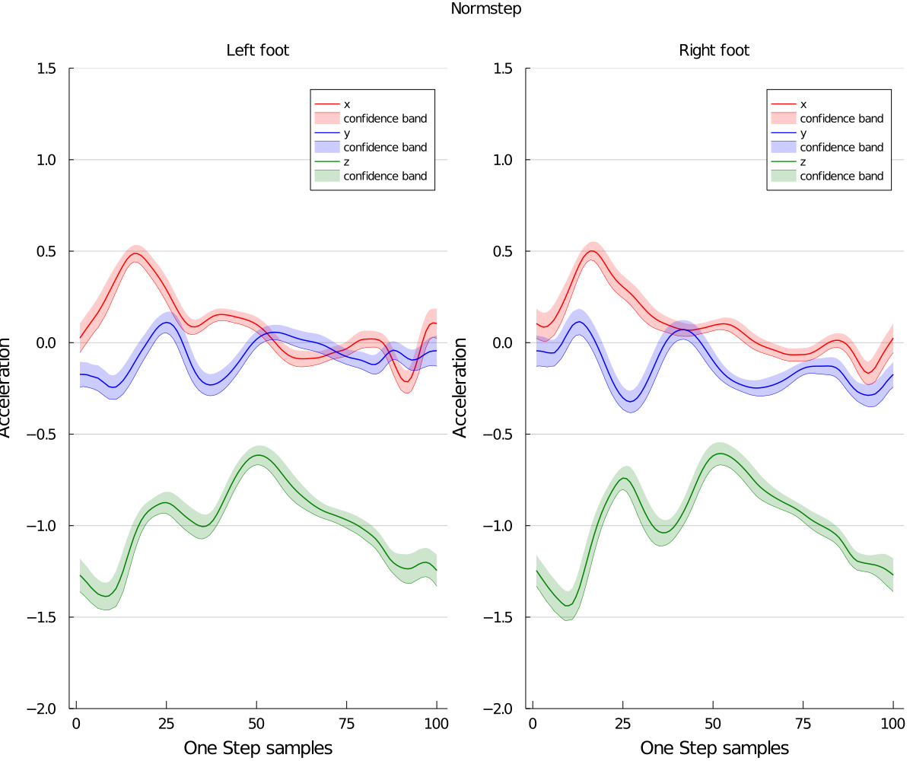
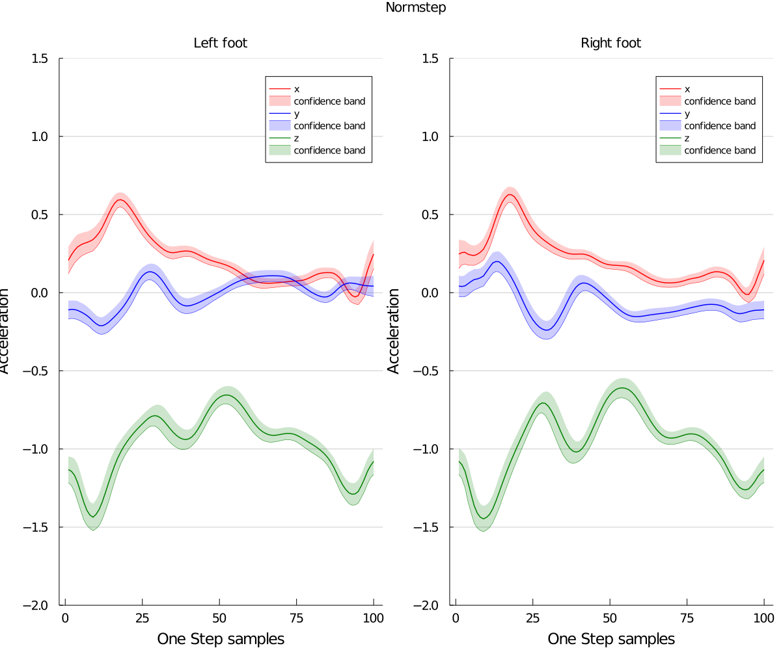
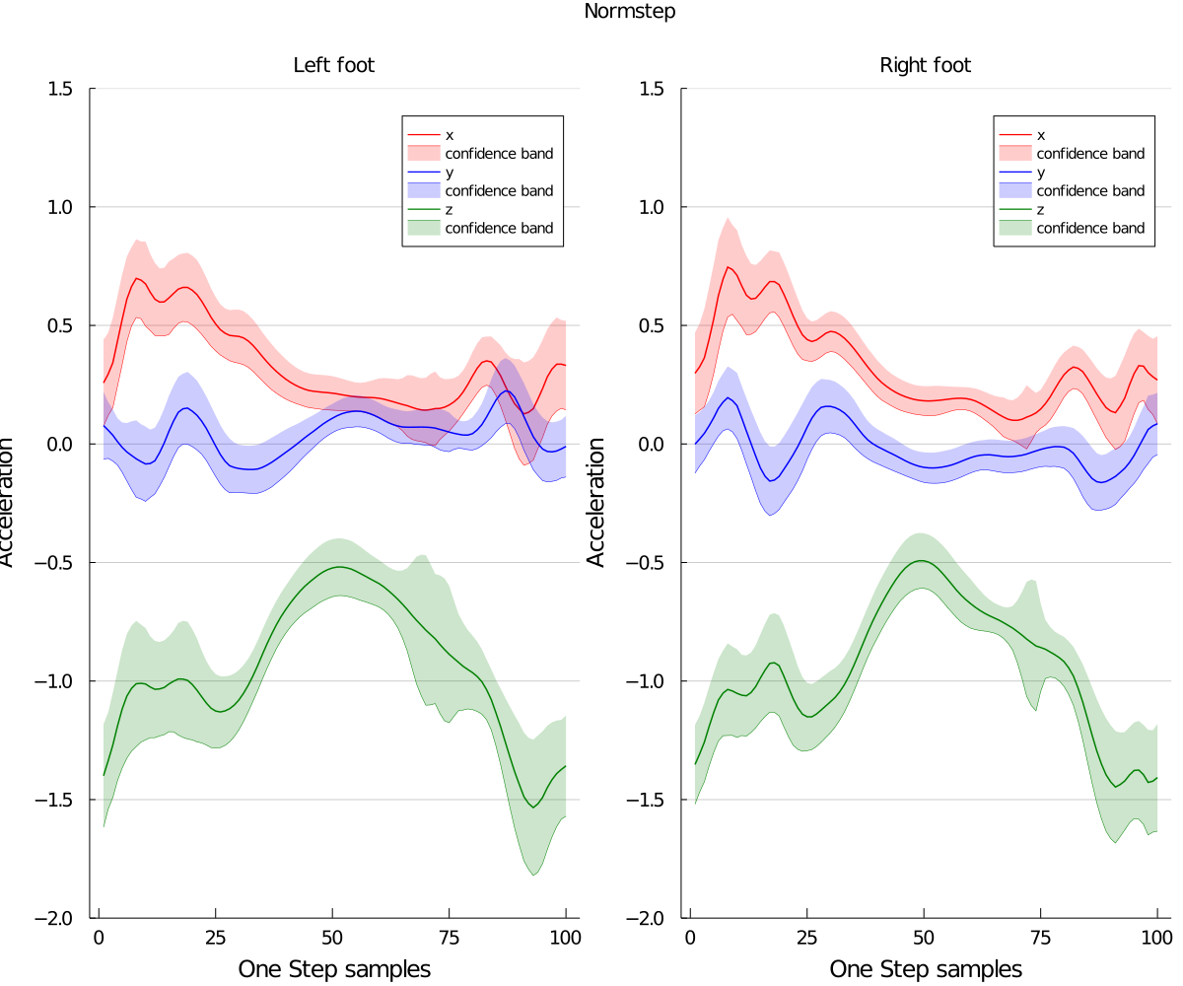
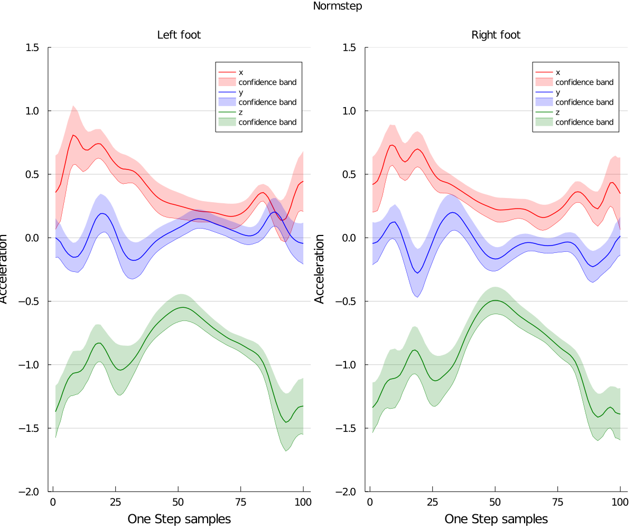
Normstep curves
Aydin
Oussama

Slide 10
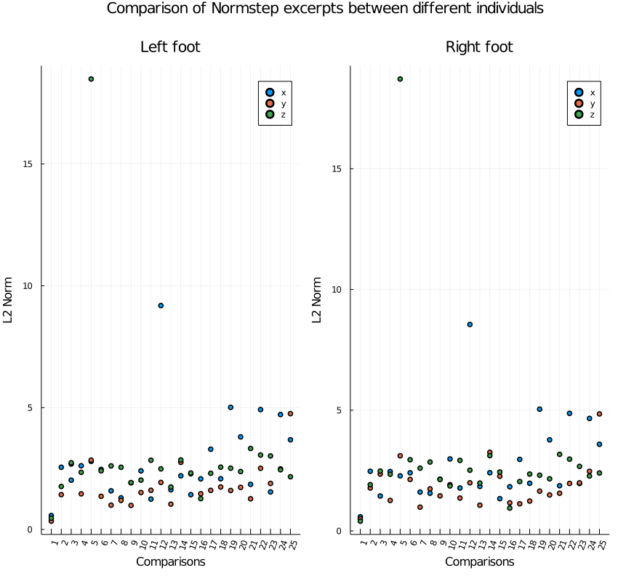
Normstep comparison

Slide 11
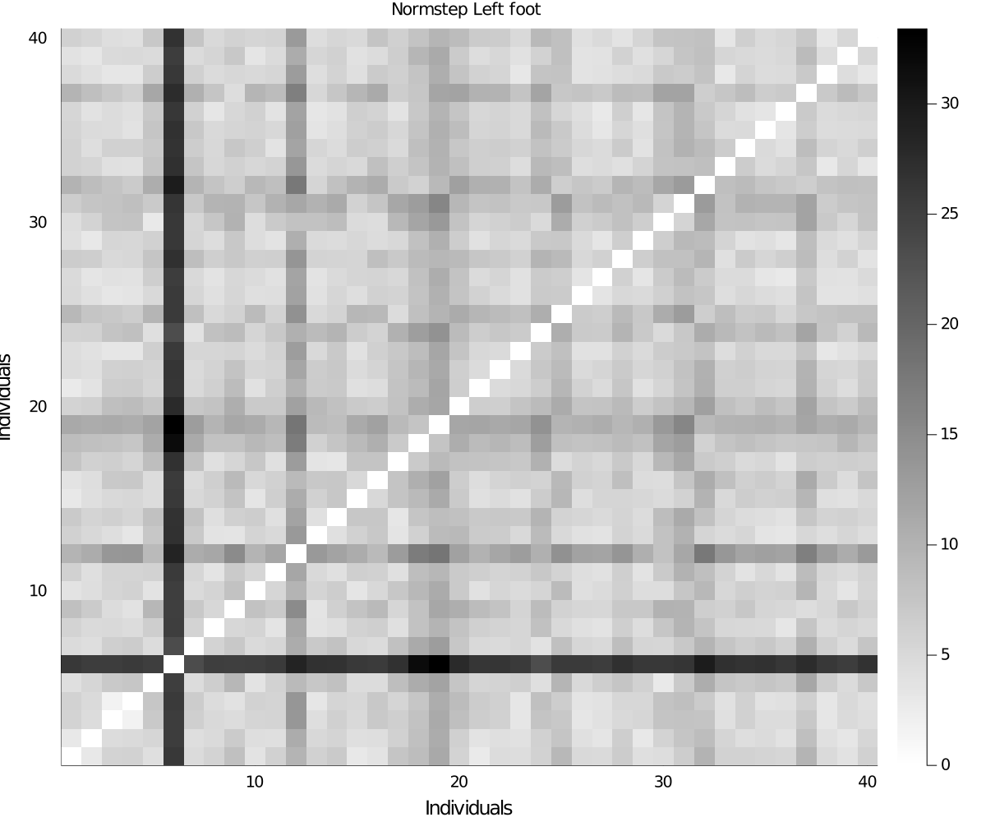
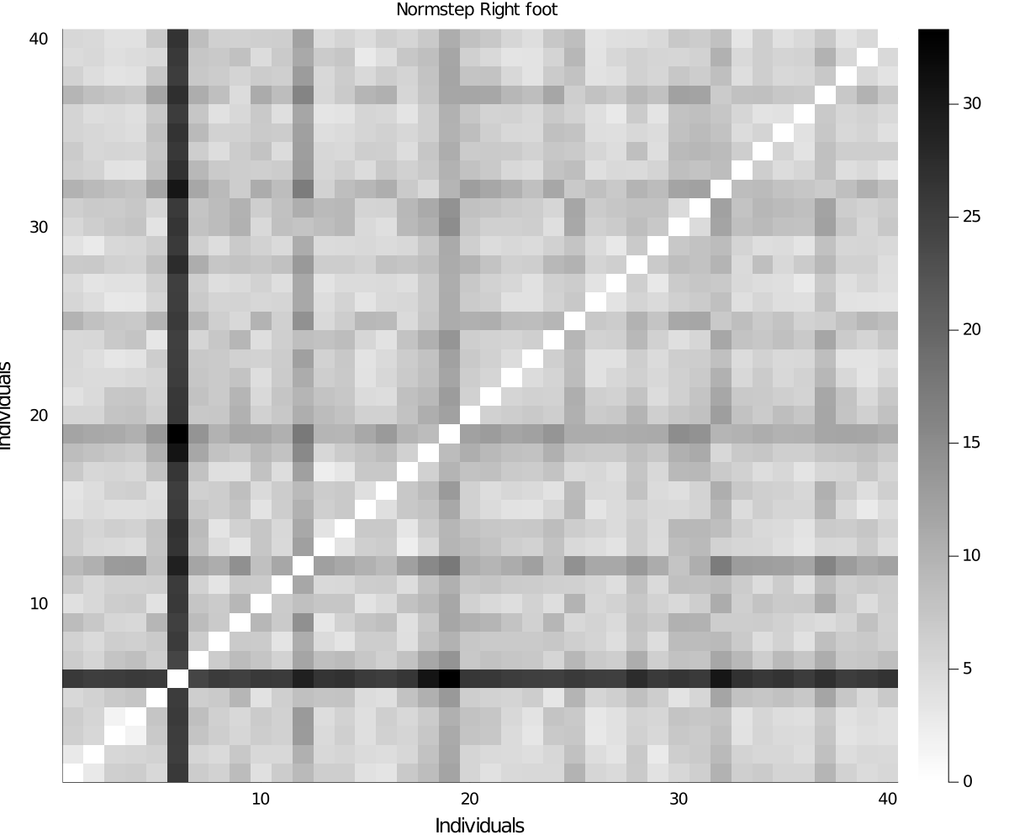
Normstep comparison
(-) L2 distance between curves doesn‘t really penalize the fluctuations of a curve

Slide 12
Future work
Adding an L2 distance on derivatives of curves
Possibility to understand the meaning of peaks of the normsteps

Slide 13
References
[1] Connor, P., & Ross, A. (2018). Biometric recognition by gait: A survey of modalities and features. Computer Vision and Image Understanding, 167, 1–27. https://doi.org/10.1016/j.cviu.2018.01.007
[2] Gait Analysis Mission impossible. (2019, March 7). [Video]. YouTube. https://www.youtube.com/watch?v=VNcArJ5ems8

Slide 14
Thank you for your attention!

